Slide 1

Principal Component Analysis
Aksadur Rahman
aksadur@yahoo.com

Slide 2
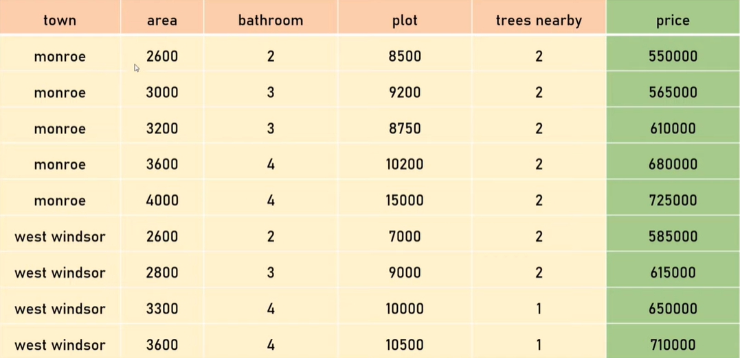

Slide 3
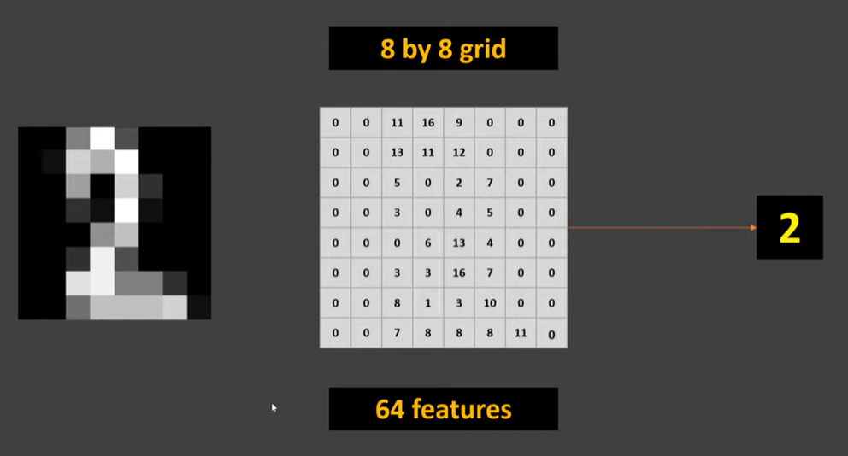

Slide 5
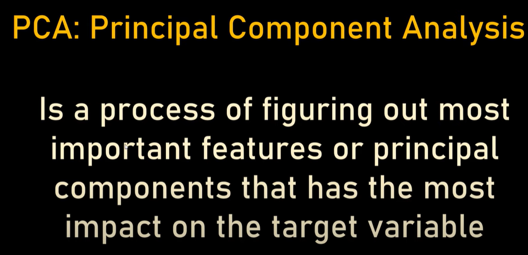

Slide 7
